Slide 1
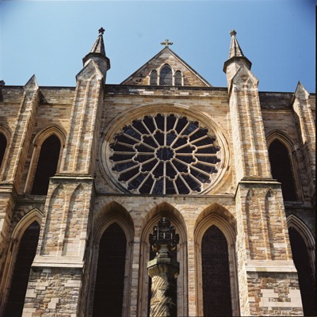
Romanesque Art 1050-1200 eleventh and twelfth centuries

Slide 2
Meaning
“In the Roman Manner”
European art and architecture
Architecture: solid masonry walls, rounded arches and vaults.
Period of building Castles, churches, monasteries, and other beautiful monuments.
Importing religious themes through art.

Slide 3
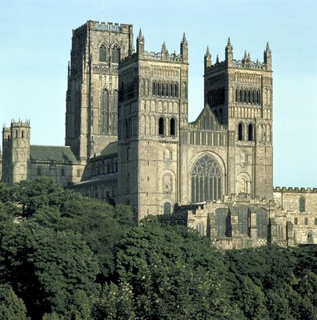
Politics, church, and economic life
Durham
Cathedral,
1093 AD
Notes:
Notice the pointed and detailed tips of the cathedral, the vaults, and arches.

Slide 4
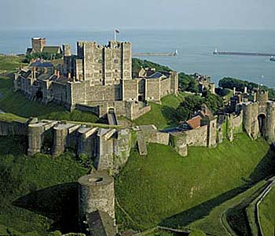
Dover Castle
Notes:
Solid masonry walls, Lacks the harsh detail of streamline romanesque

Slide 5
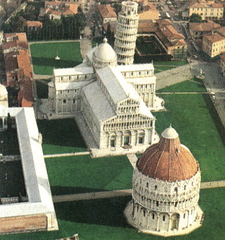
Cathedral Complex, Pisa-Italy
Notes:
Location Pisa, Italy map
Date 1063 to 1350 timeline
Building Type church complex
Construction System bearing masonry, cut stone, white marble
Climate mediterranean
Context church complex and tower
Style Romanesque
Notes The cathedral complex includes the famous Leaning Tower, La Torre Pendente. White marble with colonnaded facades.

Slide 6
Role of woman
Aristocratic(,) woman managed estates while men were away.
Peasant men and woman worked side by side
Woman achieved authority and influence through religious communities.
Educated woman lived in Monasteries and created many of the historical “Illuminated Manuscripts” we have record of.
An illuminated manuscript is a manuscript in which the text is supplemented by the addition of decoration, such as decorated initials, borders (marginalia) and miniature illustrations.
Notes:
Aristocratic: Aristocracy is a form of government, in which a few of the most prominent citizens rule. This may be a hereditary elite, or it may be by a system of cooption where a council of prominent citizens and leading soldiers, merchants, land owners, priests, and lawyers to their number.

Slide 7
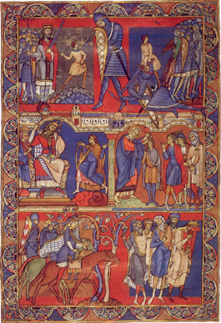
Tapestry to Illustrated Books Chi Rho Iota page from the book of Kells, vellum,
Notes:
Romanesque art was highly decedent and emerged through illustrated texts. Fancy boarders, intricate detail, and a restricted color palette define illustrations of this time.
Book of Kells( Gothic) was created a century earlier but impacted roman art significantly.
Vellum:, for "calfskin")[1] is mammal skin prepared for writing or printing on, to produce single pages, scrolls, codices or books.

Slide 8
The Mouth of Hell, Winchester Psalter
Notes:
Hellmouth is the entrance to hell envisioned to be a gaping mouth of a huge monster, an image which first appears in Anglo-Saxon art, and then spread all over Europe.

Slide 9
Boarder, detail, and design
Notes:
Line and Color- Intricate border and details communicates the message.

Slide 10
Illustration
Choose a fable, religious, or political theme
Using only images create a communicative illustration.
Incorporate a limited color palette and intricate details including a boarder.

Slide 11
Project

